Slide 1


Communication and Generalization in Multi-Agent Learning
Jiaxun Cui
Ph.D. Defense | August 1 2025
Learning Agent Research Group

Slide 2
Conversational AI
ChatGPT
Reasoners
GPT-o3, DeepSeek-R1, Gemini-2.5 Pro
Autonomous Agents
Take actions autonomously for extended periods, taking actions on a user’s behalf
Innovators
Develop new ideas, inventions, solutions, and scientific breakthrough
Organizations
Effectively manage and operate entire organizations, making strategic decisions and optimizing performance
OpenAI 2024

Slide 3
Socialized Generalist Agents
Operate in mixed-autonomy environments, coexisting with human and other AI agents
Being able to communicate with humans and other agents
Generalize effectively to respond to a wide range of human and agent behaviors

Slide 4
Socialized Generalist Agents
Communication
Generative
Agents 2023
Cicero
2022
PSRO
2017
AlphaStar
2019
OpenAI Five
2019
Multi-Agent Policy Generalization
Habitat 2019
SayCan 2022
Fictitious
Co-Play
2021
Human Compatibility
Notes:
Human compatibility: human behaviors and human language

Slide 5
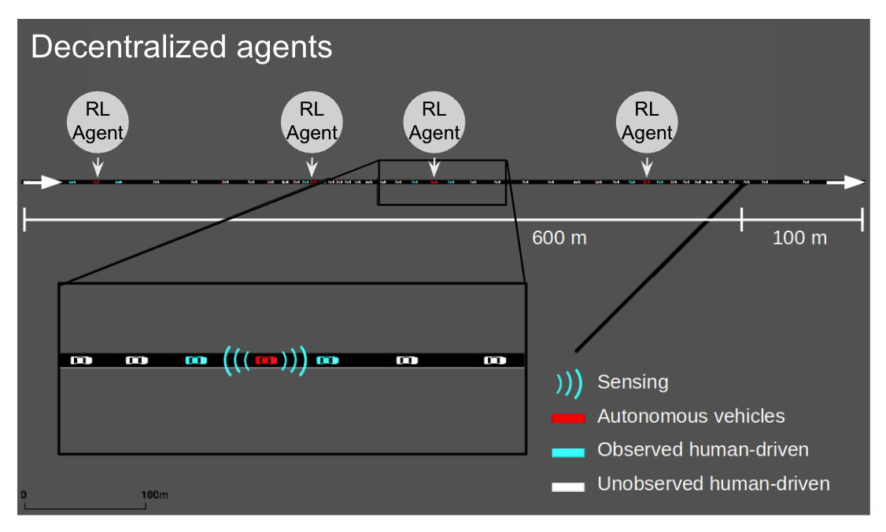
Multi-Agent Policy Generalization
Communication
Human Compatibility
COOPERNAUT
Cui et al. CVPR 2022
Talking Vehicles
Cui et al. Under Review 2025
FLOW
Cui et al. AAMAS 2021
L-BRDiv
Rahman and Cui et al. AAAI 2024
MACTA
Cui et al. ICLR 2023
Notes:
1. FLOW 2021: In the open collaboration scenario and when human behaviors lead to congestion, a small portion of autonomous agents could help improve the systematic traffic efficiency
2. Coopernaut 2022: A method to generate message in latent representation for vehicle-2-vehicle communication 3. MACTA 2023: An application of game-theoretic reinforcement learning for the cache timing attacks
I

Slide 6
Multi-Agent Policy Generalization
Communication
Human Compatibility
Talking Vehicles
Cui et al. Under Review 2025
L-BRDiv
Rahman and Cui et al. AAAI 2024
COOPERNAUT
Cui et al. CVPR 2022
FLOW
Cui et al. AAMAS 2021
MACTA
Cui et al. ICLR 2023

Slide 7
FLOW
When human behaviors lead to traffic congestions, a small portion of autonomous agents in the mixed-autonomy can help improve systematic efficiency in traffics
$$R_{individual}=η_{1} ∗ R_{selfish}+η_{2} ∗ R_{coopertiave}+bonus$$
Cui, Jiaxun, et al. Scalable multiagent driving policies for reducing traffic congestion. AAMAS 2021
Notes:
In the open collaboration scenario and when human behaviors lead to congestion, a small portion of autonomous agents could help improve the systematic traffic efficiency

Slide 8
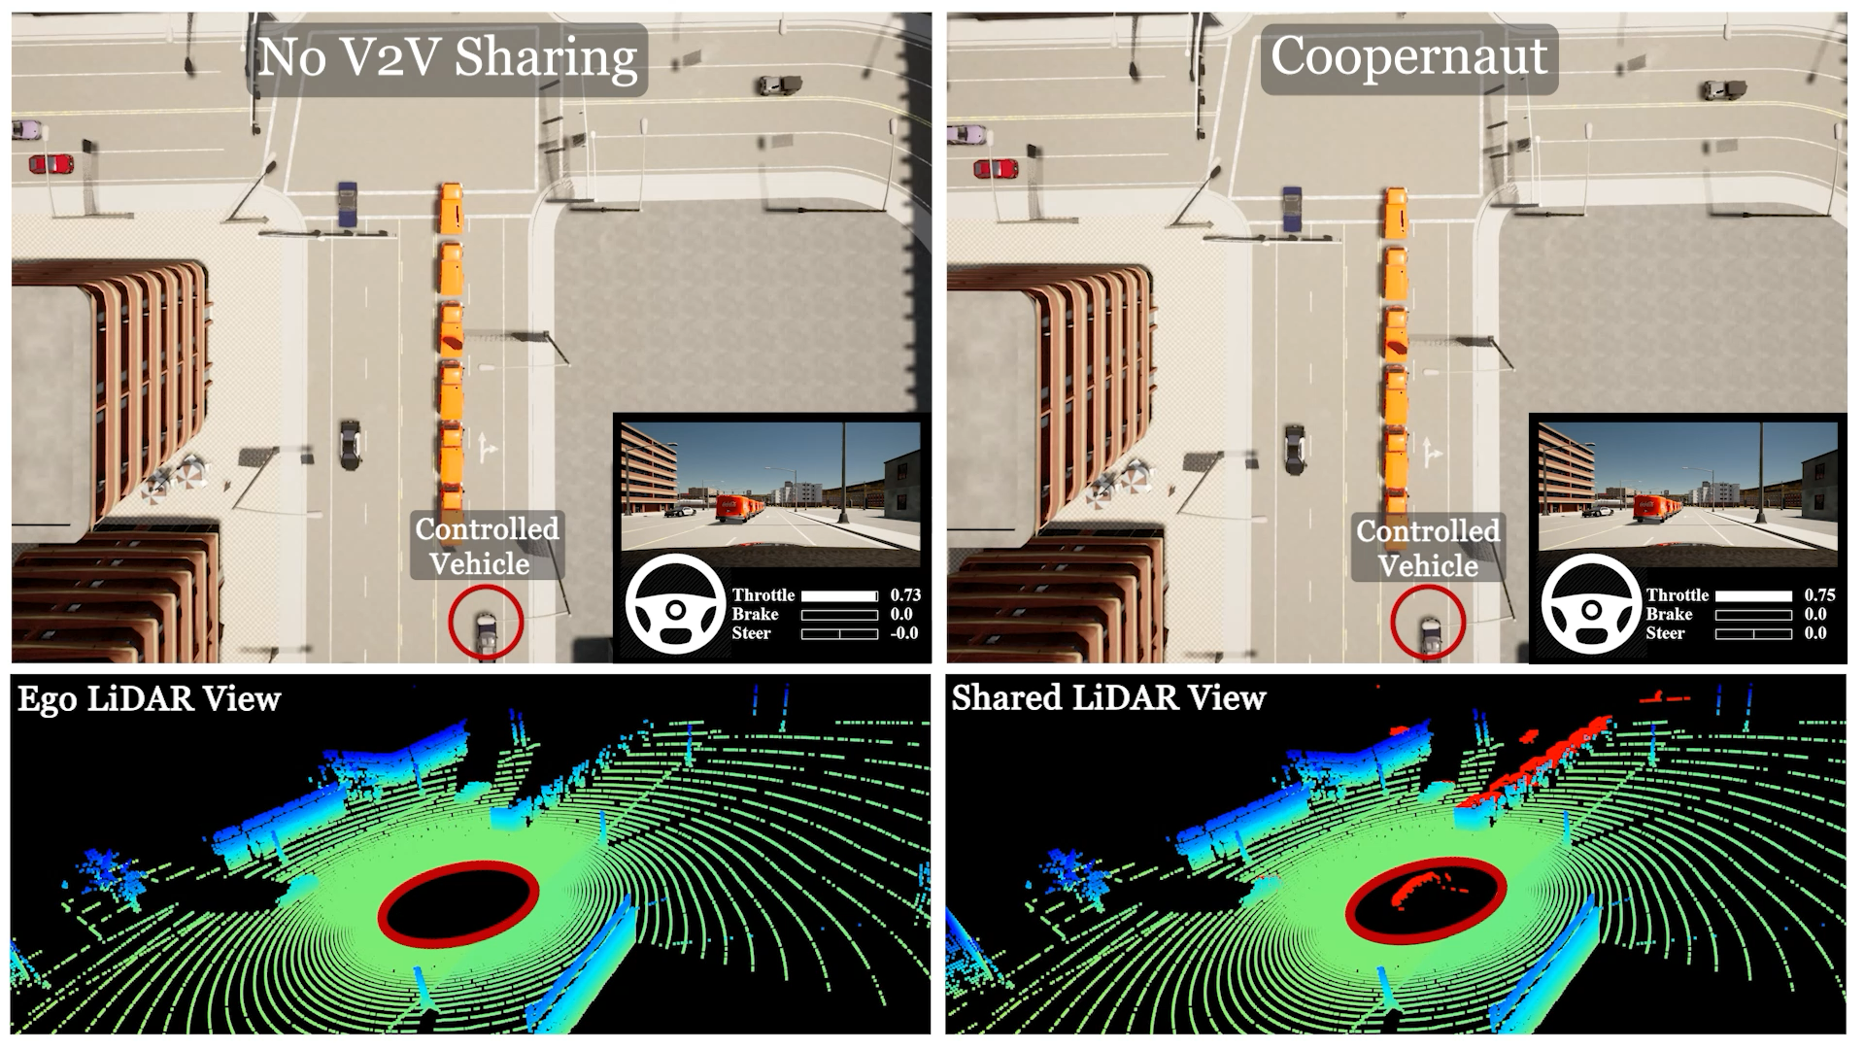
COOPERNAUT A Review

Slide 9
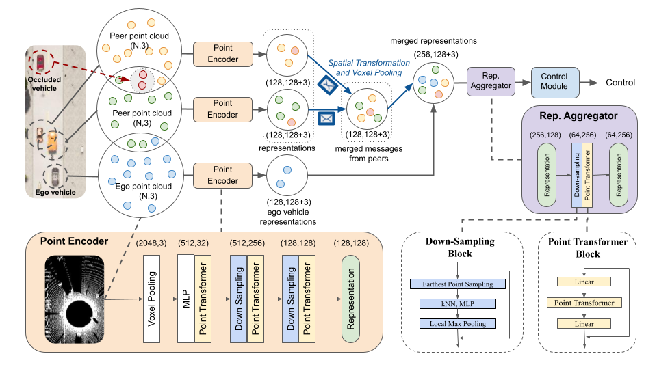
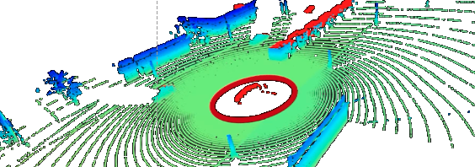
representations

Slide 10
Latent-representation messages
Human and other agents can not participate the collaboration
Can not negotiate
➔ Communicate in human language

Slide 11
Multi-Agent Policy Generalization
Communication
Human Compatibility
COOPERNAUT
Cui et al. CVPR 2022
Talking Vehicles
Cui et al. Under Review 2025
FLOW
Cui et al. AAMAS 2021
L-BRDiv
Rahman and Cui et al. AAAI 2024
MACTA
Cui et al. ICLR 2023

Slide 12
Multi-Agent Policy Generalization
Communication
Human Compatibility
Talking Vehicles
Cui et al. Under Review 2025
COOPERNAUT
Cui et al. CVPR 2022
FLOW
Cui et al. AAMAS 2021
L-BRDiv
Rahman and Cui et al. AAAI 2024
MACTA
Cui et al. ICLR 2023

Slide 13
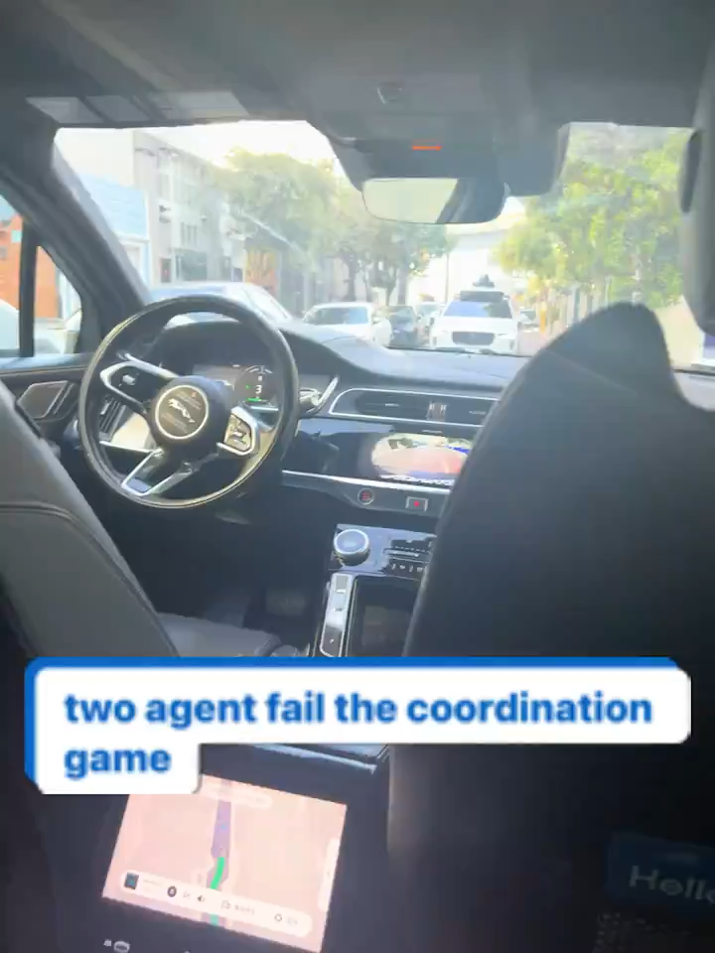
Waymo vs Waymo
Motivation Video Talking Vehicles
Notes:
Both are working in silent mode and playing the best response to human drivers

Slide 14
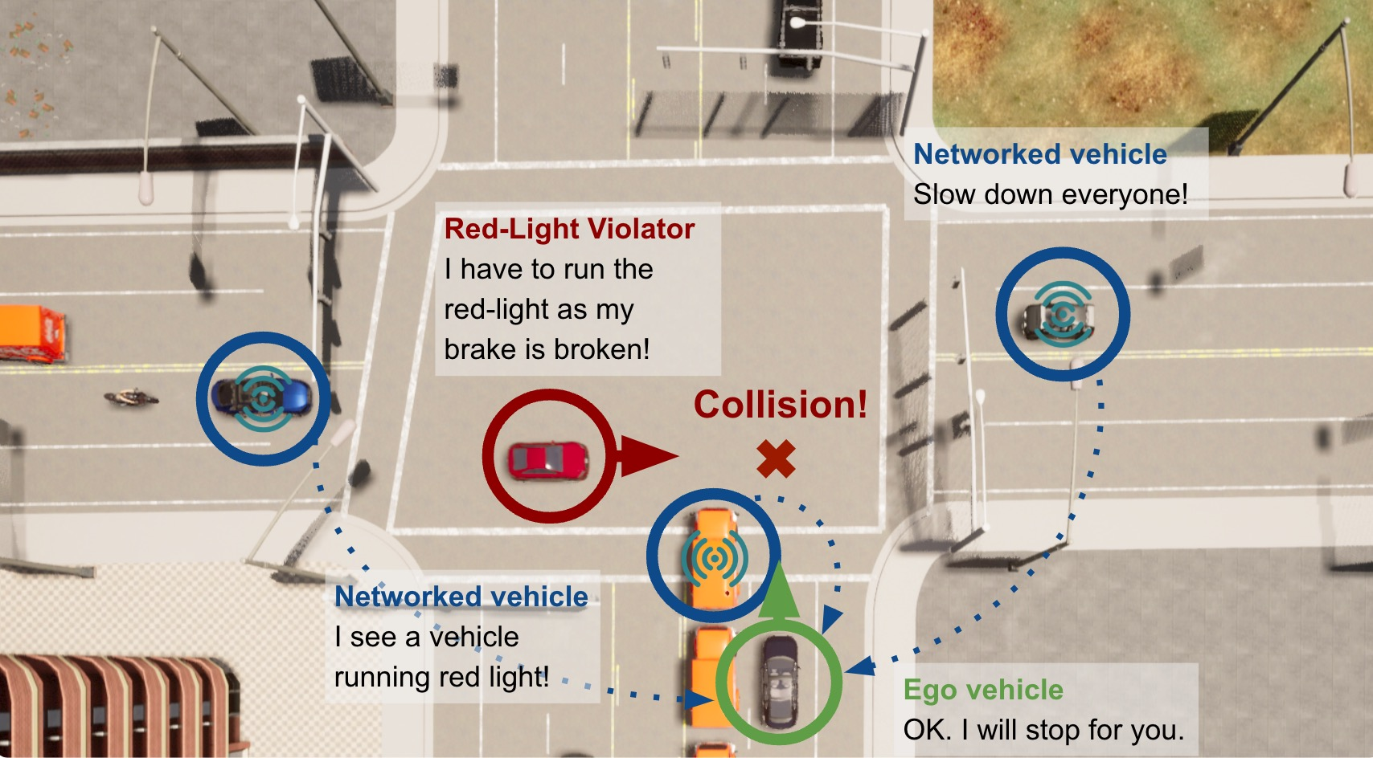

Slide 15
How to make embodied agents (cars) to speak and coordinate physically with natural language?
Different from board games, only trajectories make sense for continuous tasks
Data featuring cooperative driving in natural language does not exist! 😭
Language structural model + RL self-play finetuning [Lewis et al. 2017]
Language model behavior cloning + RL value filtering [Meta FAIR et al. 2022]
LLM diverse prompt + RL selection [Xu et al. 2023]
👉🏻 Can we learn from a few self-play interactions among LLM Agents? 🤔
M. Lewis et al. Deal or no deal? end-to-end learning for negotiation dialogues. 2017. Meta FAIR. Mastering the game of no-press diplomacy via human-regularized reinforcement learning and planning. Nature, 2022. Xu et el. Exploring large language models for communication games: An empirical study on werewolf. NeurIPS 2023.

Slide 16
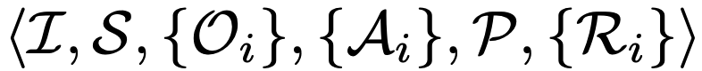
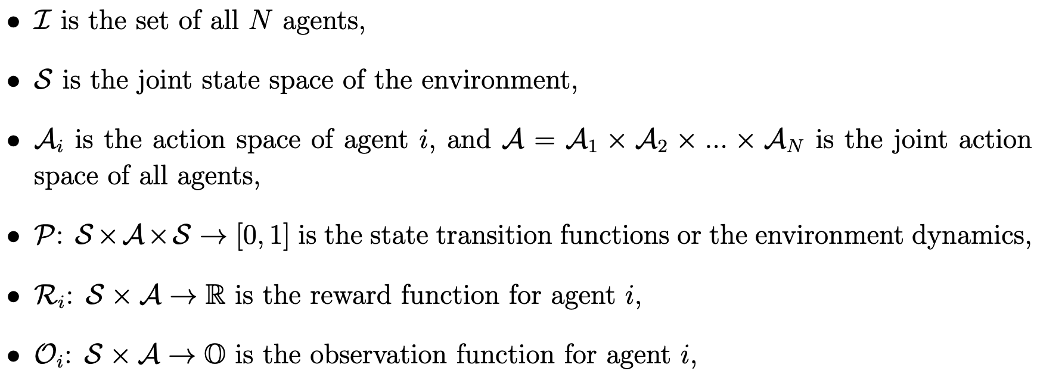
Problem Formulation I
Partially Observable Stochastic Games
Partial observability
Individual rewards that may not fully align

Slide 17
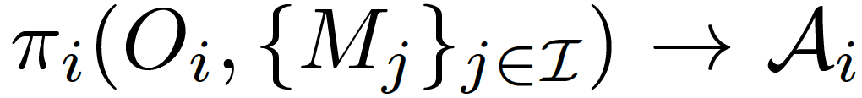
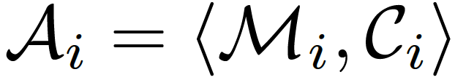
Problem Formulation II
Definition 1 (focal population) A set of controllable agents that optimize their joint rewards given any background agents.
Optimization Objectives: The social welfare of focal population agents.
Joint action space of
<messages, control>
How to generate meaningful natural language messages
How to comprehend the received natural language messages and incorporate them into high-level cooperative driving decisions?

Slide 18



In-Context Knowledge -> Autoregressive Model
Chain-of-Thought Reasoning
Agent Framework
Task
LLM Agent Policy
Observation
Chain-of-thought Reasoning
Control Command
Received Messages
Message

Slide 19
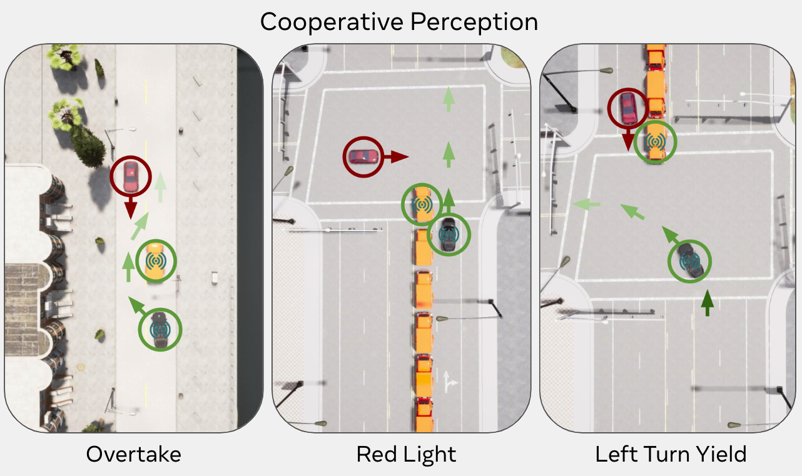
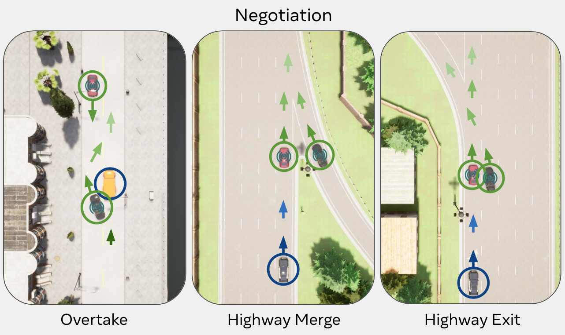
TalkingVehiclesGym Scenarios
Focal Agents
Potential Colliders
Background Agents
Language-specified Individual tasks that may not fully aligned (need to cooperate on perception or negotiation)
Text scenario description with partial observability awareness to reduce the perception difficulty
Action space: natural language message generation and atomic controls
go, slow done, speed up, stop, change to the left lane, change to the right lane

Slide 20
Can LLM agents establish collaboration without prior interactions?

Slide 21
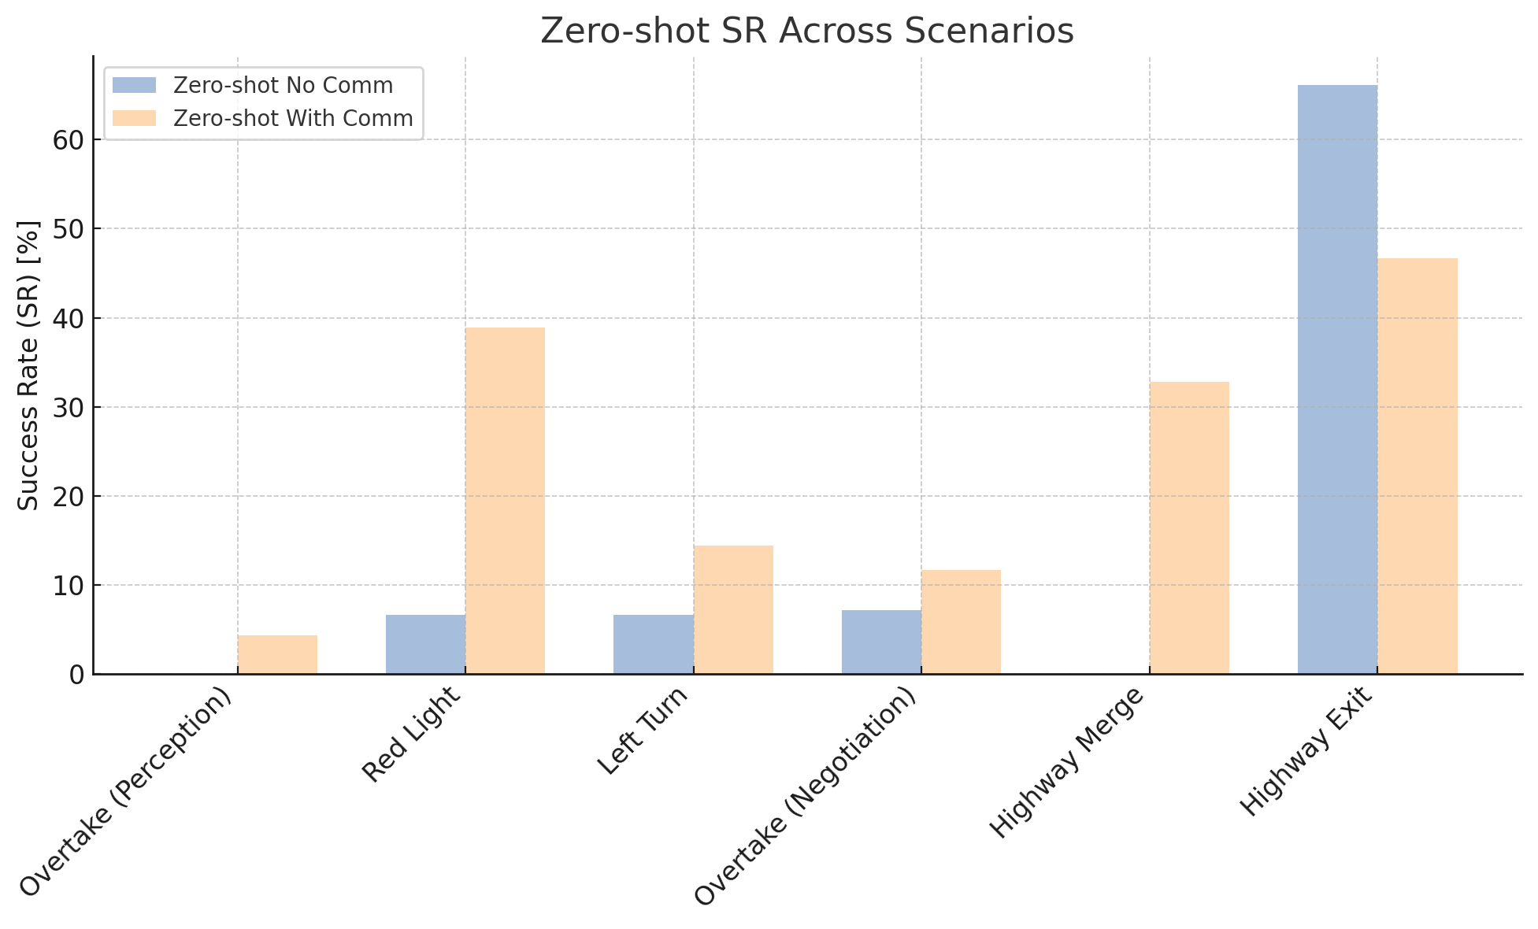
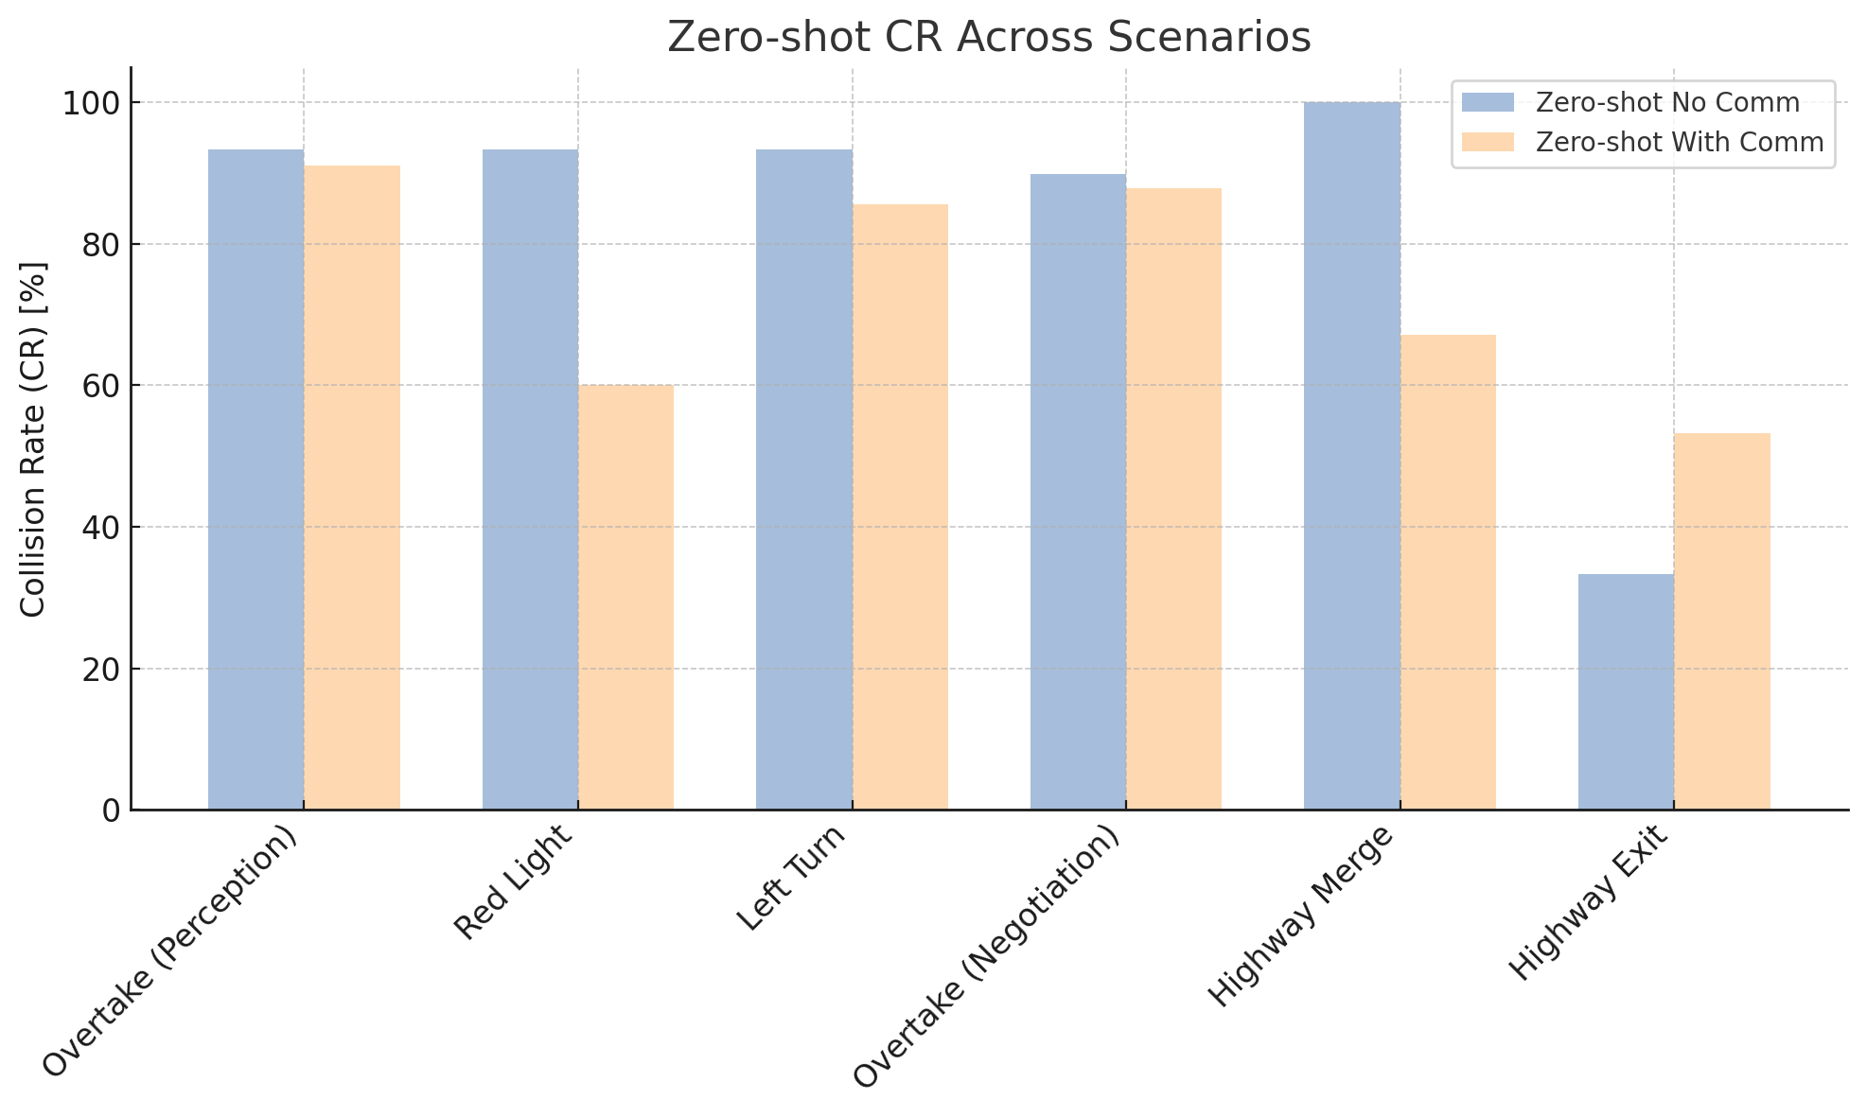
Agent Zero-shot Performance
Low Success Rates
High Collision Rates

Slide 22
agents do not communicate effectively to understand each other's needs in perception or achieve agreement in negotiation
even when the messages make sense to humans, agents do not respond with appropriate driving commands
Why do the agents fail?

Slide 23
Multi-agent learning is needed

Slide 24
Agent Framework
Task
LLM Agent Policy
Observation
Chain-of-thought Reasoning
Control Command
Received Messages
Message

Slide 25
In-Context Knowledge -> Autoregressive Model
Chain-of-Thought Reasoning
Agent Framework (learning enabled)
Task
LLM Agent Policy
Observation
Chain-of-thought Reasoning
Control Command
Received Messages
Message
Knowledge
Strategy

Slide 26
TalkingVehiclesGym Scenarios
Focal Agents
Potential Colliders
Background Agents
Diagnostic verbal feedback “vehicle 111 collides with vehicle 120” “Vehicle 109 stagnated too long for the task”

Slide 27


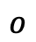
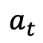
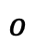
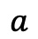
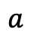
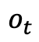

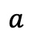
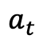
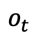
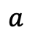
Replay Buffer
Rollout interaction trajectories
Retrospectively relabel each time step when the episode concludes
$$a_{t}$$
$$o_{t}$$
$$o$$
$$a$$
$$o$$
$$a$$
$$o$$
$$a$$
$$a$$
$$o$$
$$a_{t}$$
$$o_{t}$$
Message Passing

Slide 28
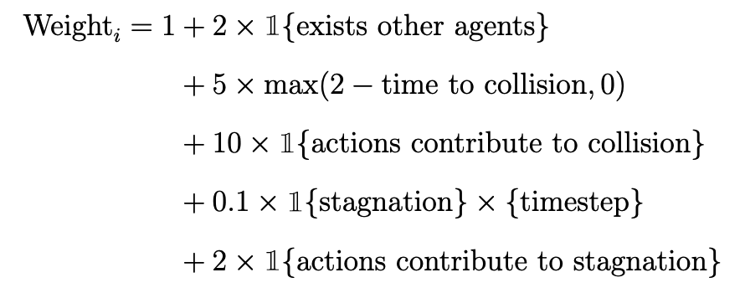
Replay Buffer
Rollout interaction trajectories
Retrospectively relabel each time step when the episode concludes
Prioritized batch sampling for trajectory analysis
$$a_{t}$$
$$o_{t}$$
$$o$$
$$a$$
$$o$$
$$a$$
$$o$$
$$a$$
$$a$$
$$o$$
$$a_{t}$$
$$o_{t}$$
Message Passing

Slide 29



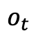
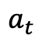
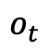
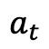
LLM+Debrief
$$a_{t}$$
$$o_{t}$$
This is the interaction trajectory and the feedback on the task.
$$a_{t}$$
$$o_{t}$$
I think we failed the task because … I propose that A should do xxx, and I will do xxx…
Why did the collision / stagnation happen?
Here is a revised cooperation strategy, I will do xxx, and B will do xxx
Context Reflection
Debrief

Slide 30
Research Questions
Does enabling natural language communication necessarily enhance the coordination of LLM agents from those without?
Does decentralized reflection improve collaborative capability over interactions?
Does centralized discussion among LLM agents provide additional improvements in collaboration and communication compared with decentralized reflection?

Slide 31
Metrics and Baselines
60 episodes Round-Robin among randomly shuffled [risky, safe] scenarios with 50% vs 50% percentage. Early Stop with 20 Consecutive Successful Episodes
Metrics
Average Total Reward normalized by group size
Average Success Rate normalized by group size
Average Collision Rate normalized by group size
Baselines in both Silent and Comm mode
Zero-shot
Decentralized Reflection
Centralized Debrief
Correction + RAG [Wen et al., 2023]
gpt-4o-mini for “fast” acting (~8s)
gpt-4o for analysis & reflection
Wen, Licheng, et al. "Dilu: A knowledge-driven approach to autonomous driving with large language models." arXiv preprint arXiv:2309.16292 (2023).

Slide 32
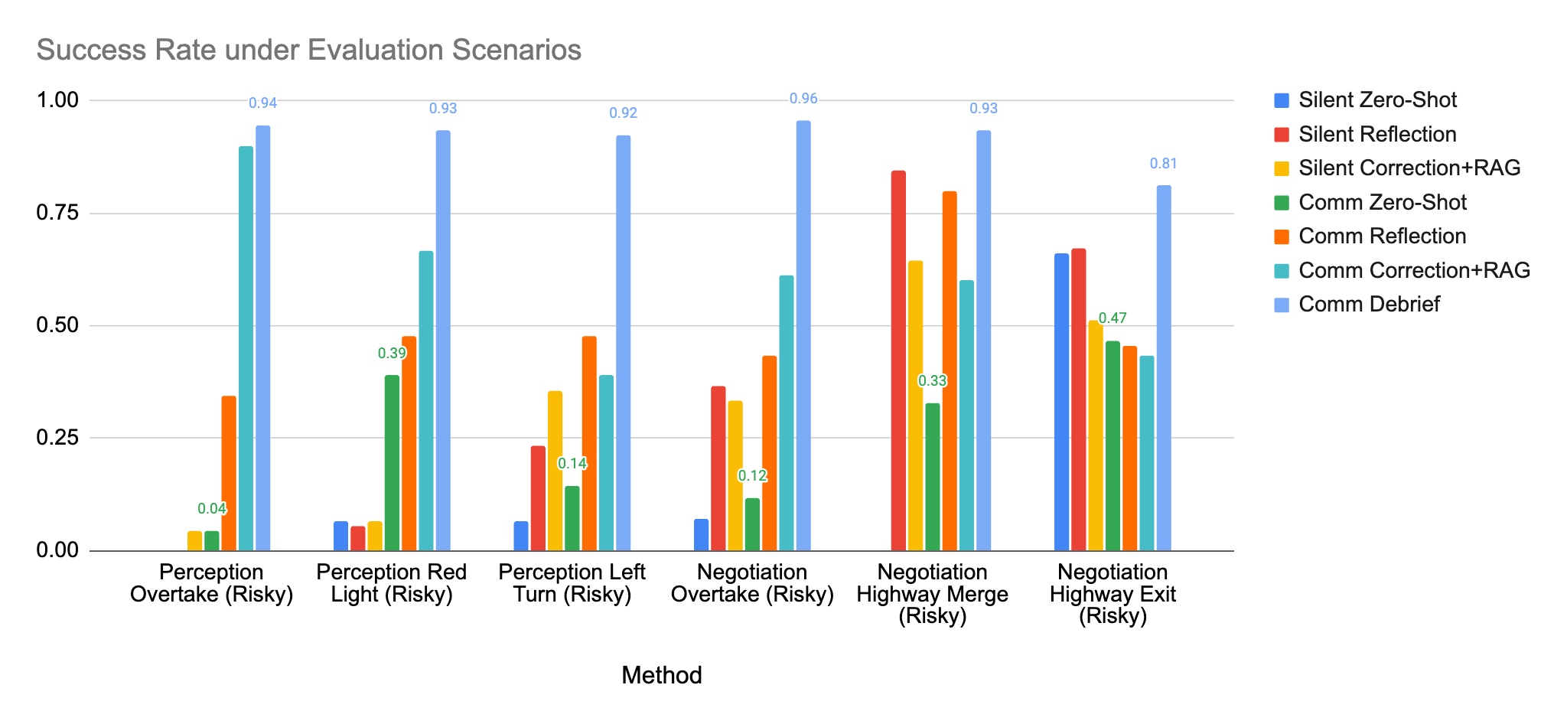
Quantitative Results

Slide 33
Findings
Communication does not guarantee collaboration in zero-shot interactions ❌ {gpt-4o-mini, llama3-8b-instruct, gpt-4o, gpt-o4-mini}
Decentralized reflection and correction with RAG memory reduce collisions. ✅
Centralized debriefing enhances coordination more than decentralized reflection. ✅
The potential of natural language communication for multi-agent ✅❌

Slide 34
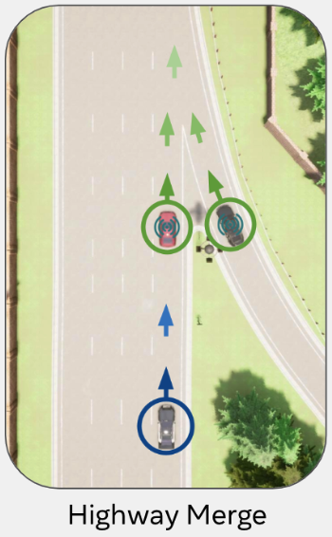
Example Generated Cooperation Strategy
Highway Merge (Negotiation) Knowledge learned by the merging vehicle
Knowledge To effectively merge onto the highway when in a hurry, I should initiate communication by clearly stating my intention to merge, including my current speed and position. As I approach the merge point, I will gradually accelerate to match the highway speed. Continuous communication is essential to coordinate actions and avoid collisions. I must maintain a safe merging distance and speed, avoiding abrupt maneuvers. I should also be prepared to adjust my speed dynamically based on real-time feedback from the highway vehicle.,
Cooperative Strategy In our cooperative strategy for merging onto the highway, the merging vehicle (myself) will initiate the process by clearly communicating its intention to merge, including its current speed and position. As the merging vehicle approaches, it will gradually accelerate to match the highway speed, ensuring a smooth transition. The vehicle in the rightmost lane of the highway will proactively create a gap by slightly reducing its speed earlier, allowing the merging vehicle to enter the lane without needing to match speeds precisely. Throughout the process, both vehicles will maintain clear communication, with the merging vehicle leading in signaling its actions and the highway vehicle responding by adjusting speed to facilitate a safe merge.

Slide 35
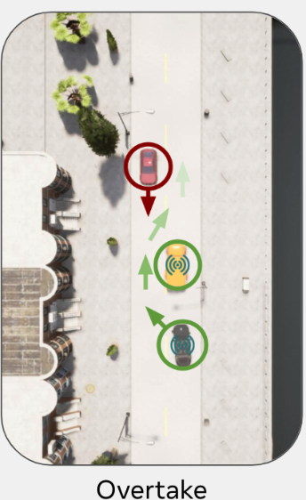
Emergence of Concise Communication Protocol Overtake (Perception) Communication Protocol by LLM+Debrief, seed 12, checkpoint-28
In the revised cooperative strategy, the stationary truck in lane 1 will continuously monitor the traffic in lane -1 and provide real-time updates on the speed and distance of oncoming vehicles. If the gap is not safe for overtaking, the stationary truck will send a “hold” message to prevent premature maneuvers. As the overtaking vehicle, I will use my sensors to independently verify the traffic conditions in lane -1 and maintain a flexible speed, ready to adapt dynamically. I will only proceed with the overtaking maneuver when both the stationary truck's updates and my sensor data confirm a safe gap, at which point the stationary truck will send a “go” message. This dual verification approach ensures alignment in our actions, minimizing the risk of collision and avoiding stagnation by allowing me to adjust my speed based on real-time conditions. If no safe gap is available, I will maintain my position and communicate my readiness to adapt speed as necessary, ensuring a coordinated and safe overtaking process.

Slide 36
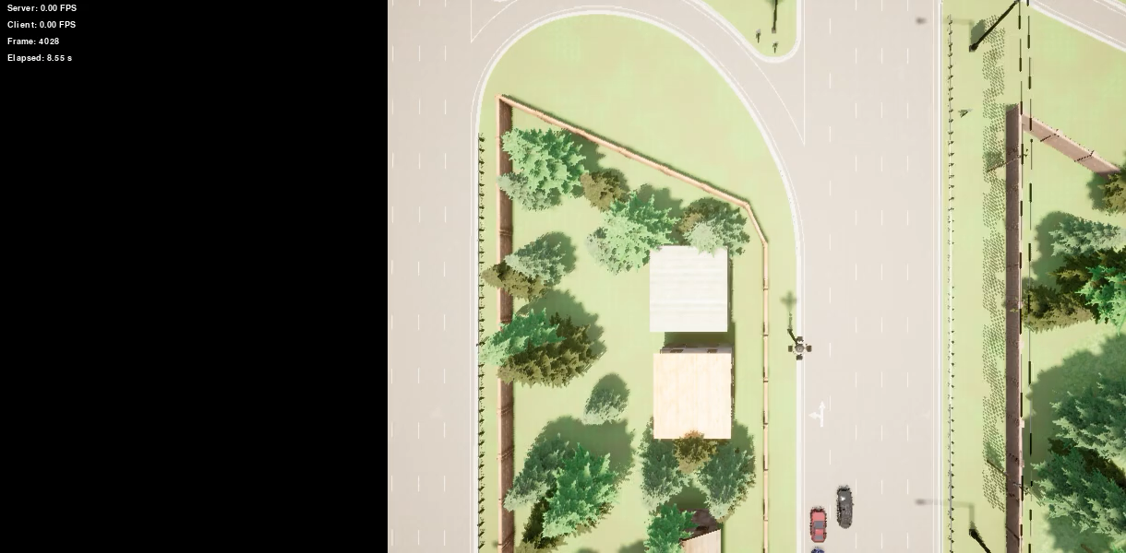
Qualitative videos

Slide 37




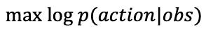
Scenario Generalization A single policy that works for all roles and scenarios
Store knowledge from all vehicles
Store successful interaction trajectories
<observation , action >
Behavior cloning with a small language model
Retrieve relevant knowledge
$$max log p(action|obs)$$
Centralized Memory
Distillation

Slide 38
Inference Time & Message Size Reduction
10 Seconds
Decision
Latency
<0.5 Seconds
Compared with large model
5.1 Mbps
Bandwidth Requirement
<0.01 Mbps
Compared with Coopernaut

Slide 39
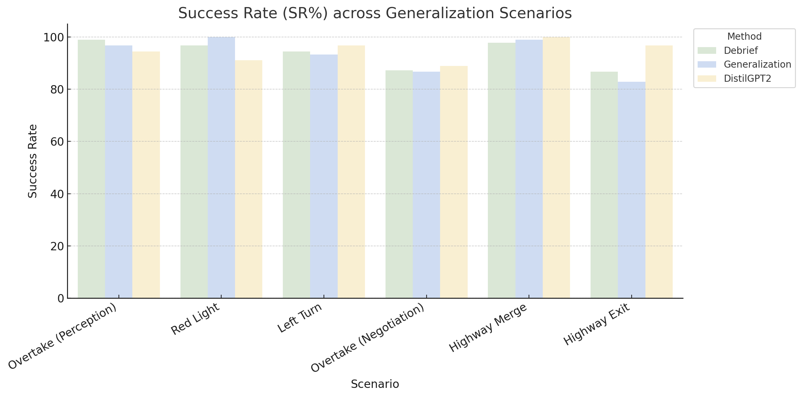
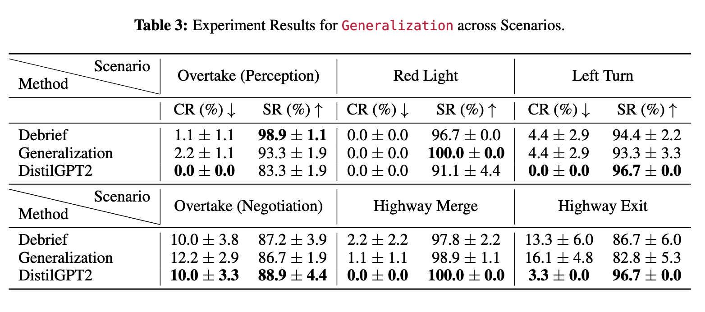
Distilled model trained by filtered BC maintains performance

Slide 40


Slide 41
Among the first V2V natural language communication systems in simulation with policy optimization
Novel multi-embodied-LLM agent self-play learning method

Slide 42
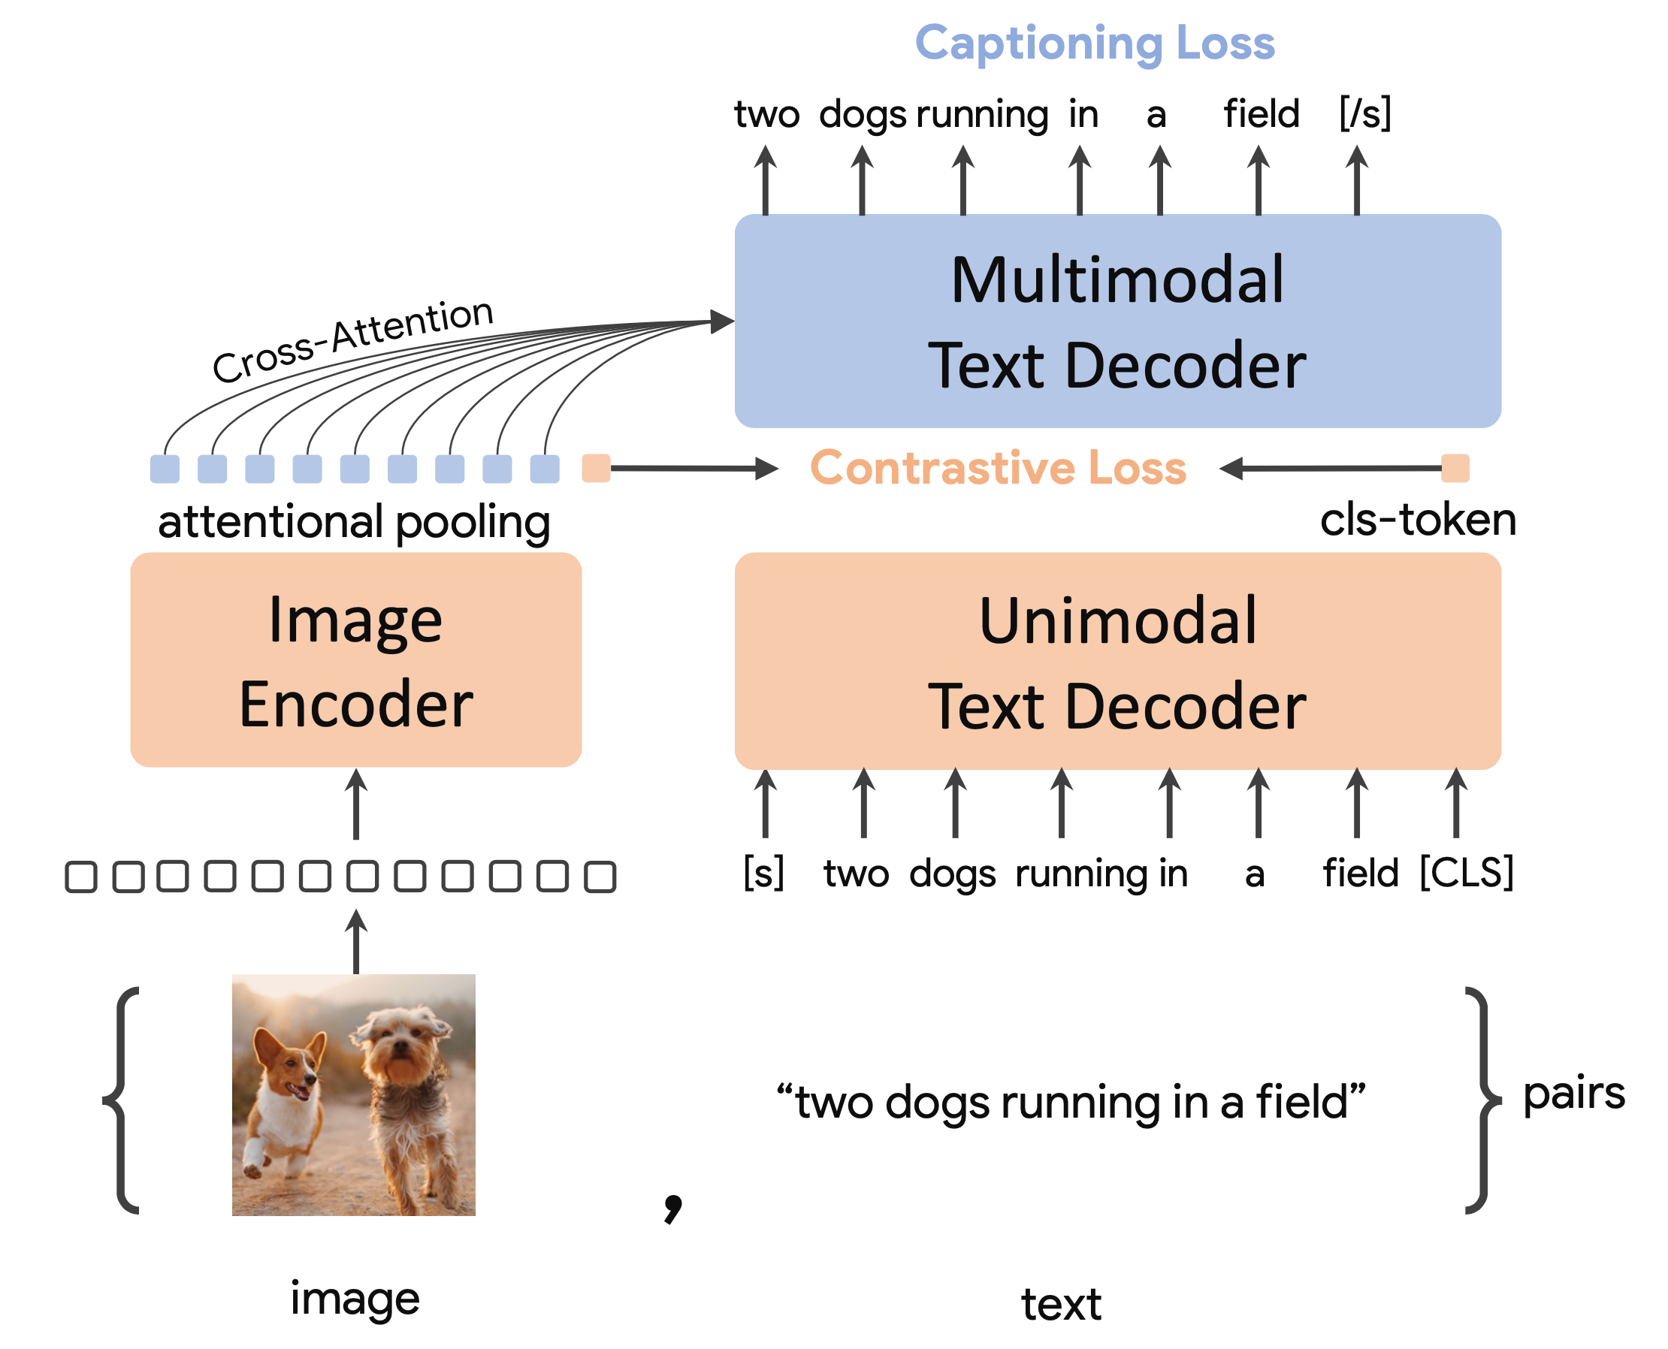
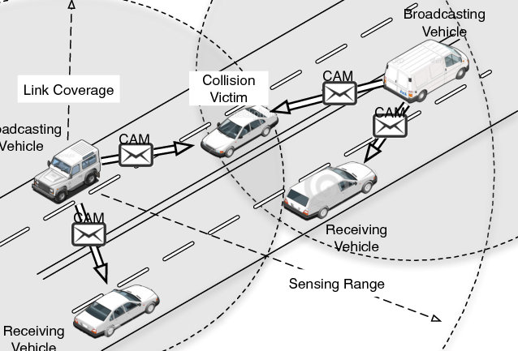
Discussion
1. VLM / MLLM to use sensor perceptions / physical understanding / planning
2. Imperfect communication considering time delays package losses, and corruption
3. Adversarial attack on collaboration
4. Ad hoc teamwork

Slide 43
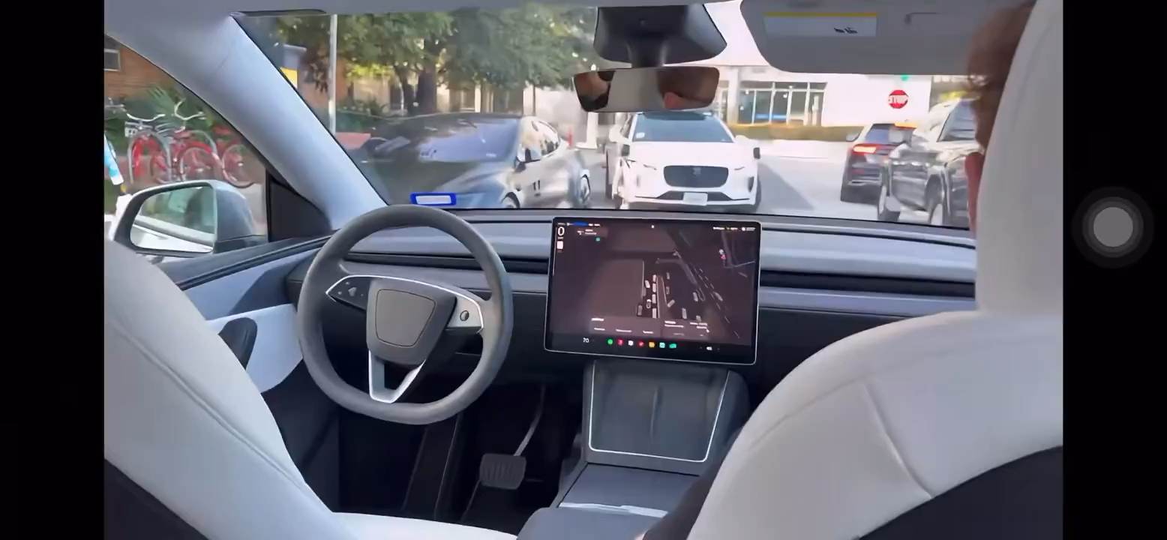
Tesla vs Waymo
Tesla vs Waymo video

Slide 44
Multi-Agent Policy Generalization
Communication
Human Compatibility
COOPERNAUT
Cui et al. CVPR 2022
Talking Vehicles
Cui et al. Under Review 2025
FLOW
Cui et al. AAMAS 2021
L-BRDiv
Rahman and Cui et al. AAAI 2024
MACTA
Cui et al. ICLR 2023

Slide 45
Multi-Agent Policy Generalization
Communication
Human Compatibility
L-BRDiv
Rahman and Cui et al. AAAI 2024
COOPERNAUT
Cui et al. CVPR 2022
Talking Vehicles
Cui et al. Under Review 2025
FLOW
Cui et al. AAMAS 2021
MACTA
Cui et al. ICLR 2023

Slide 46
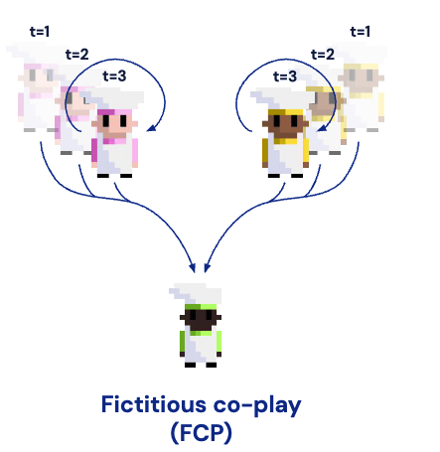
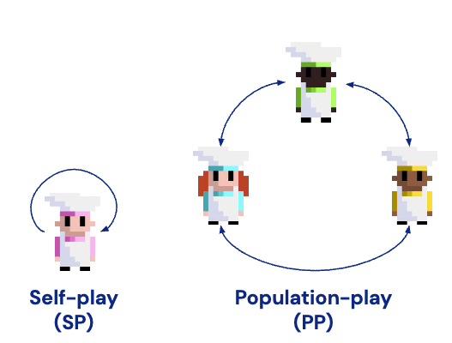
Multi-Agent Policy Generalization means being able to achieve good performance against previously unseen agents.
Such generalization can be achieved by generating diverse training partners in the population- based training methods
Strouse et al., Collaborating with Humans without Human Data, NeurIPS 2021

Slide 47
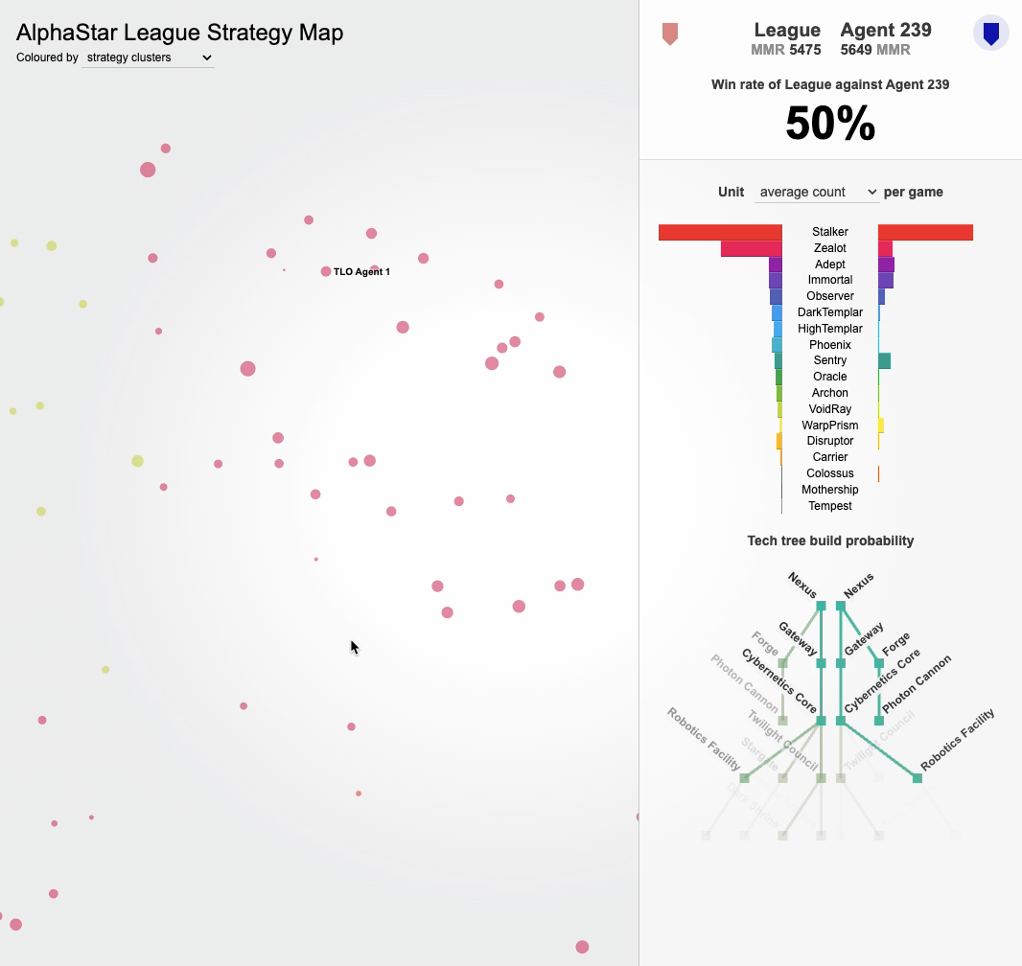
Source: AlphaStar website

Slide 48
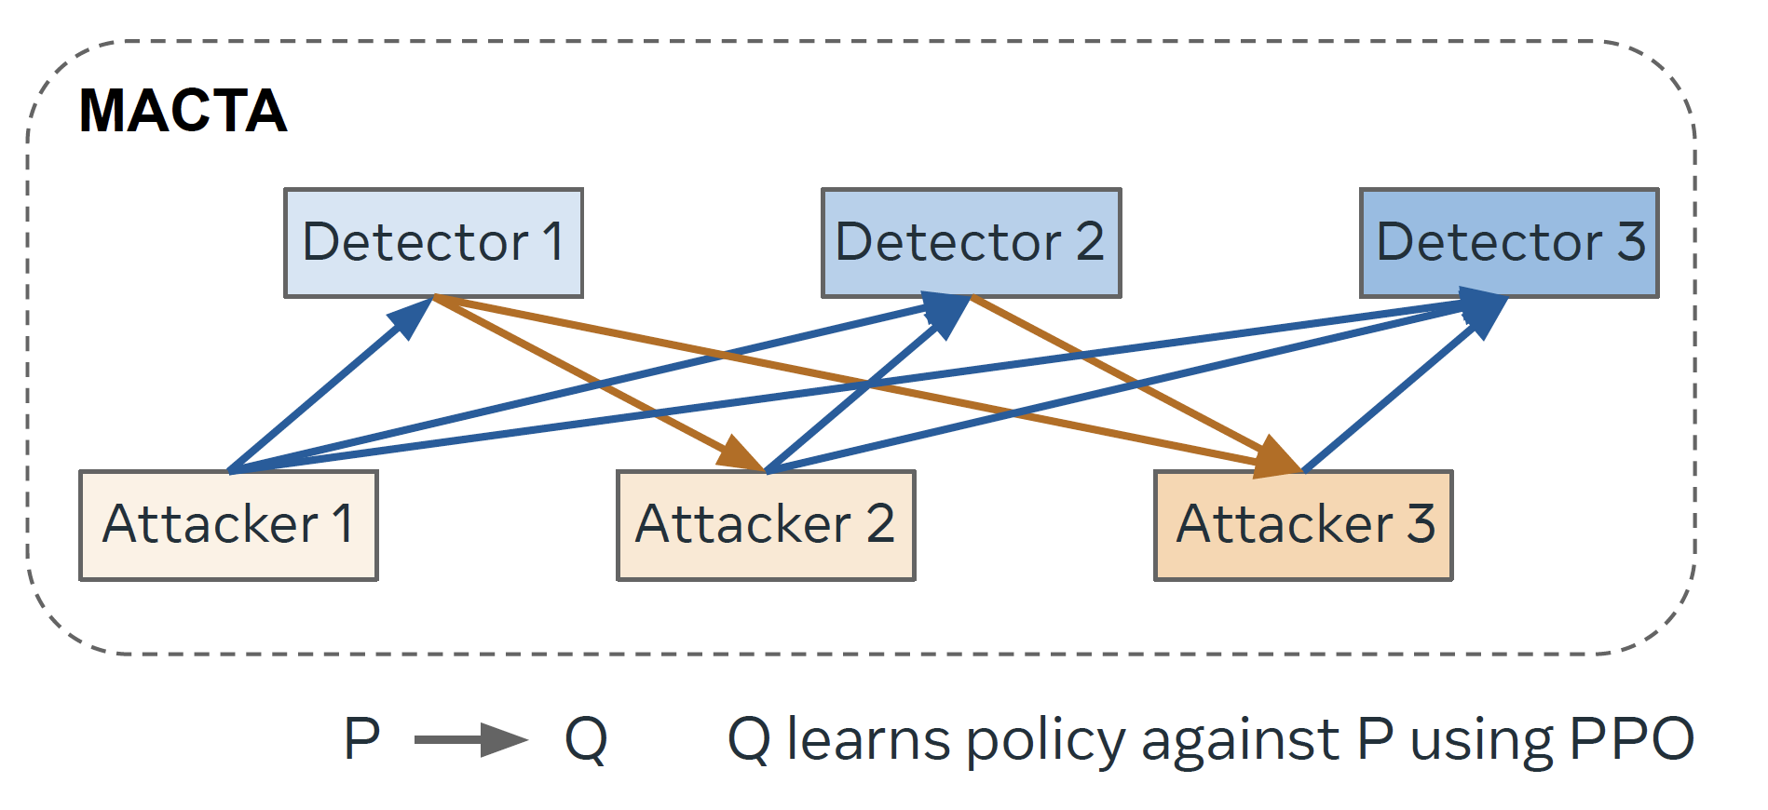
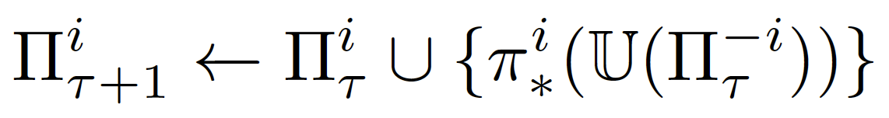
Generating diverse training partners is easier in adversarial games
😈 needs to execute a few steps to complete an attack which steals information and 🕵️‍♂️ needs to find out and terminate the 😈 as soon as possible, without hurting 🤗
🕵️‍♂️
🤗
😈
😈
😈 Attacker 🤗 Benign Programs 🕵️‍♂️ Detector
🤗
🤗
Cui et al., MACTA: A Multi-Agent Reinforcement Learning Approach for Cache Timing Attacks and Detection. ICLR 2023

Slide 49
Generating diverse training partners is harder in fully cooperative games
Independent policy gradient converges to a Nash policy in fully cooperative Markov games
Proof sketch: (1) A fully cooperative Markov game is a Markov Potential Game (MPG) (2) Smoothness of potential function under SoftMax parameterization
(3) Monotonic potential ascent
(4) Vanishing gradient implies Nash
A “convention” in fully cooperative game is actually a Nash equilibrium
NE finding algorithms (IPPO, PSRO, etc.) does not encourage diverse policy finding in cooperative games!
[1] Leonardos et al., Global convergence of multi-agent policy gradient in Markov potential games, 2021
[2] Zhang et al., Gradient play in stochastic games: stationary points, convergence and sample complexity, 2024

Slide 50
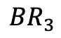
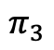
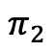
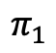
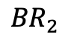
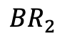













Adversarial Diversity
$$π_{1}$$
$$π_{2}$$
$$π_{3}$$
$${BR}_{1}$$
$$max R_{i, −i}$$
Maximize self-play return
$${BR}_{2}$$
$$min R_{i, −j}$$
Minimize cross-play return
$${BR}_{3}$$
$$π_{1}$$
$$π_{2}$$
$$π_{3}$$
$$π_{1}$$
$$π_{2}$$
$$π_{2}$$
$${BR}_{1}$$
10
0
4
$${BR}_{1}$$
10
0
0
$${BR}_{2}$$
0
6
4
$${BR}_{2}$$
0
6
6
$${BR}_{3}$$
4
4
6
$${BR}_{2}$$
0
6
6
Notes:
distinct conventions that are not compatible with each other 1. set up a few policy pairs
However, depending on the game reward functions, this method does not necessarily return all the distinct conventions

Slide 51

Minimum Coverage Sets
The set of best responses that can cover all the policy clusters, removing any policy of it can not cover the entire space.
Teammates that require different BRs
Notes:
We are particularly interested in generating policies that requires distinct best responses, so that the ad hoc teamwork agent could learn to emerge more best responses

Slide 52






Finding Minimum Coverage Sets
Constraint Satisfaction Problem
for all $i, j$ policy pairs
$$π_{1}$$
$$π_{2}$$
$$π_{3}$$
$${BR}_{1}$$
$$max R_{i, −i}$$
Prioritize high self-play reward
$${BR}_{2}$$
$${\left(1\right) R}_{i, −j}<R_{i, −i}$$
$${BR}_{i}$$
is not the best response to others
$${\left(2\right) R}_{j, −i}<R_{i, −i}$$
is the best response to
$${BR}_{3}$$
$${BR}_{i}$$
$$π_{i}$$

Slide 53


Lagrange Dual Problem
for all policies
$$ℒ\left(π, λ, ν\right)= f_{0\left(π\right)}+ \sum_{i=1}^{m}{λ_{i}f_{i\left(π\right)}}+ \sum_{j=1}^{n}{ν_{j}h_{j\left(π\right)}}, λ_{i}≥0$$
$$\min_{λ≥0} \max_{π} ℒ\left(x, λ\right)$$
Dual Gradient Descent

Slide 54
Constraint Satisfaction Problem
for all $i, j$ policy pairs
$$π_{1}$$
$$π_{2}$$
$$π_{3}$$
$${BR}_{1}$$
$$max R_{i, −i}$$
Prioritize high self-play reward
$${BR}_{2}$$
$${\left(1\right) R}_{i, −j}<R_{i, −i}$$
$${BR}_{i}$$
is not the best response to others
$${\left(2\right) R}_{j, −i}<R_{i, −i}$$
is the best response to
$${BR}_{3}$$
$${BR}_{i}$$
$$π_{i}$$

Slide 55



Constraint Satisfaction Problem
for all $i, j$ policy pairs
$$π_{1}$$
$$π_{2}$$
$$π_{3}$$
$${BR}_{1}$$
$$max R_{i, −i}$$
Prioritize high self-play reward
$${BR}_{2}$$
$${\left(1\right) R}_{i, −j}+τ≤R_{i, −i}$$
$${BR}_{i}$$
is not the best response to others
$${\left(2\right) R}_{j, −i}+τ≤R_{i, −i}$$
is the best response to
$${BR}_{3}$$
$${BR}_{i}$$
$$π_{i}$$
$$τ>0$$

Slide 56


Slide 57




L-BRDiv generates diverse teammates that requires different best responses
Policy Optimization
fixed Lagrange multipliers
Dual Update
fixed policies
$$max ( R_{i, −i}+∑λ_{i,j}^{1}\left(R_{i, −j}−R_{i, −i}\right)+∑λ_{j,i}^{2}(R_{j, −i}−R_{i, −i}))$$
$$λ_{i,j}^{1}←λ_{i, j}^{1}+η(R_{i, −j}−R_{i, −i})$$
$$λ_{j,i}^{2}←λ_{j, i}^{2}+η(R_{j, −i}−R_{i, −i})$$
Policy update using MAPPO [1]
$$λ=max (λ,0)$$
[1] Yu, Chao, et al. "The surprising effectiveness of ppo in cooperative multi-agent games." Advances in neural information processing systems 35 (2022): 24611-24624.

Slide 58

Norms of Lagrange Multipliers
Lagrange multipliers increases when the constraints are not satisfied, and decreases when the constrains are satisfied

Slide 59














Ad Hoc Teamwork Evaluations
$$π_{1}$$
$$π_{2}$$
$$π_{3}$$
$${BR}_{1}$$
$$π_{1}$$
$$π_{2}$$
$$π_{3}$$
$${BR}_{2}$$
$${BR}_{3}$$
Teammate Generation
AHT Training
AHT Evaluation with Unknown Teammates
L-BRDiv encourages more diverse teammates compared with baselines
Leading to emulating more BRs and better AHT performance

Slide 60
L-BRDiv is among the first to understand adversarial diversity in cooperative games
LIPO (Charakorn et al., 2023)
BRDiv (Rahman et al., 2023)
ADVERSITY (Cui et al., 2023)

Slide 61
Future Work

Slide 62

Open-ended Ad Hoc Teamwork

Slide 63

Towards Super-human Pokémon AI

Slide 64
Future Work
Ad Hoc Teamwork
General-Sum N-Agent L-BRDiv
Ad Hoc Teamwork Benchmark
Others
Natural language communication and collaboration for embodied agents
Multi-agent strategic reasoning for LLMs
Multi-agent collaboration safety

Slide 65
Conclusion

Slide 66
Socialized Generalist Agents
Towards
Communication
Multi-Agent Policy Generalization
Human Compatibility

Slide 67
Towards Socialized Generalist Agents
Communication
Coopernaut 2022
Talking Vehicles
2025
MACTA
2023
L-BRDiv
2024
Multi-Agent Policy Generalization
Flow
2021
Human Compatibility

Slide 68
Acknowledgement

Slide 69






Slide 70





Notes:
Coauthors collaborators (no photos), labmates, friends, fellow phd students, and my favorite RLRG.

Slide 71





Slide 72

Notes:
Last bit of information that I want to share
Join meta after graduation
Working post training for multi-modal language models

Slide 73
Question & Answer

Slide 74


AHT Evaluation Environments
Repeated Matrix Game
Cooperative Reaching
Weighted Cooperative Reaching
Level-based Foraging

Slide 75

“General methods that leverage
computation are ultimately the most effective, and by a large margin.”
by Richard S. Sutton on 2019
Photo: Alberta Machine Intelligence Institute

